Slide 1
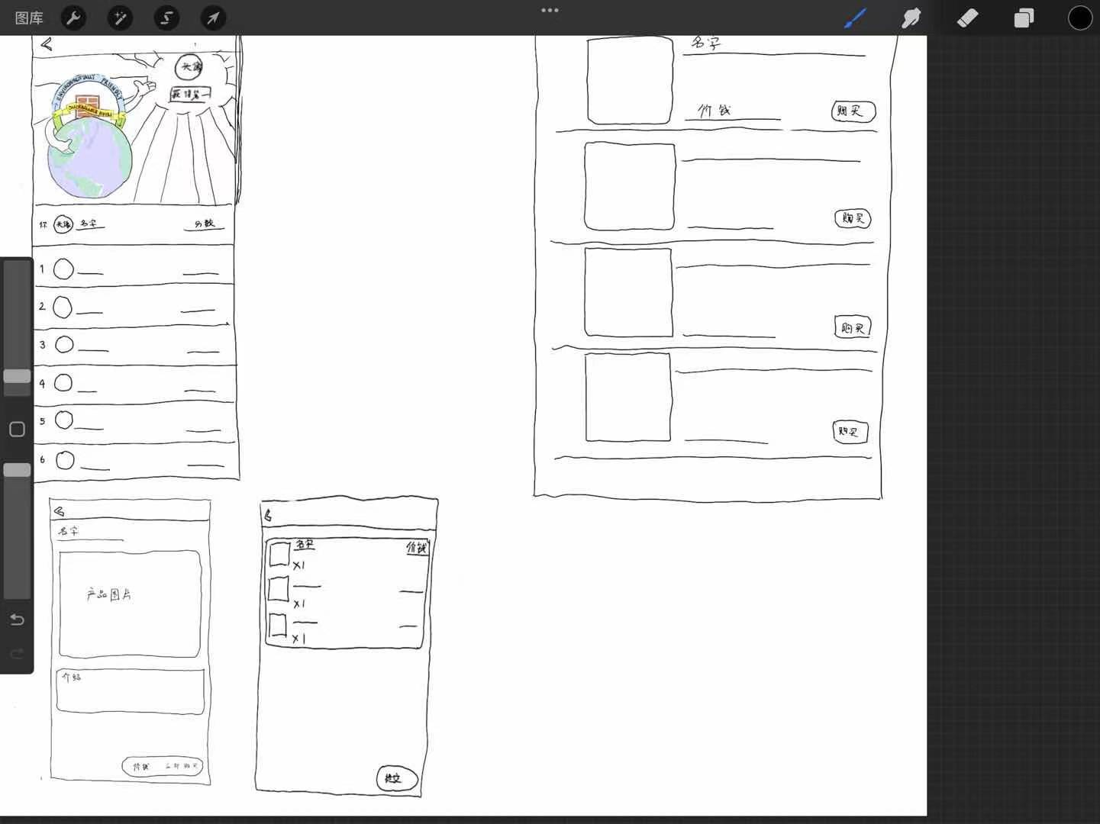

Slide 2
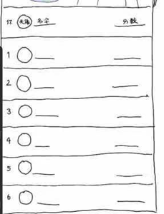








Welcome To Leaftivation!
Introduction (get it from backend)
Home
icon
Settings
Log
Awards

Slide 3

+
Past Logs:
(picture)
number
unsuccessful
Transportation type
(picture)
Transportation type
number
successful
Home
icon
Settings
Log
Awards

Slide 4
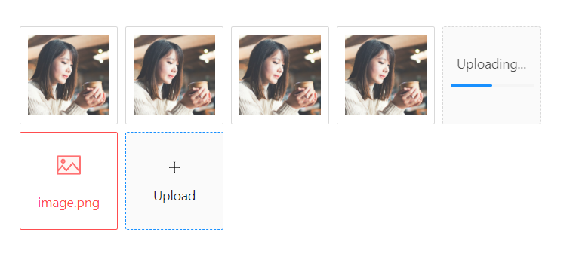


Logging
upload
Home
icon
Settings
Log
Awards

Slide 5

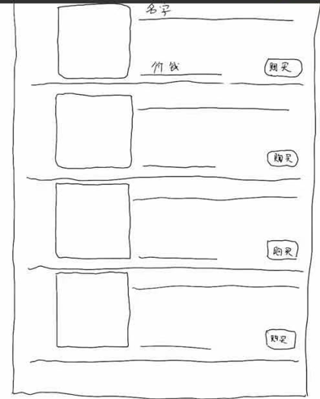






search bar
Home
icon
Settings
Log
Awards

Slide 6
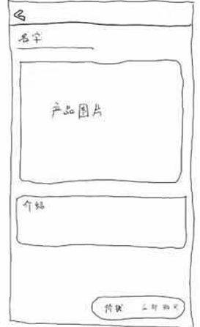


Home
icon
Settings
Log
Awards

Slide 7
Cart
picture
Name
price
- (amount) +
picture
Name
price
- (amount) +
picture
Name
price
- (amount) +
Total price: ______
Buy
Home
icon
Settings
Log
Awards

Slide 8
√
Success!

